Slide 1

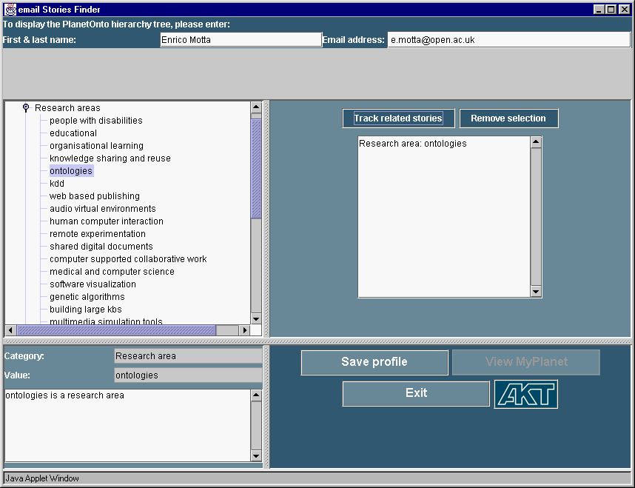
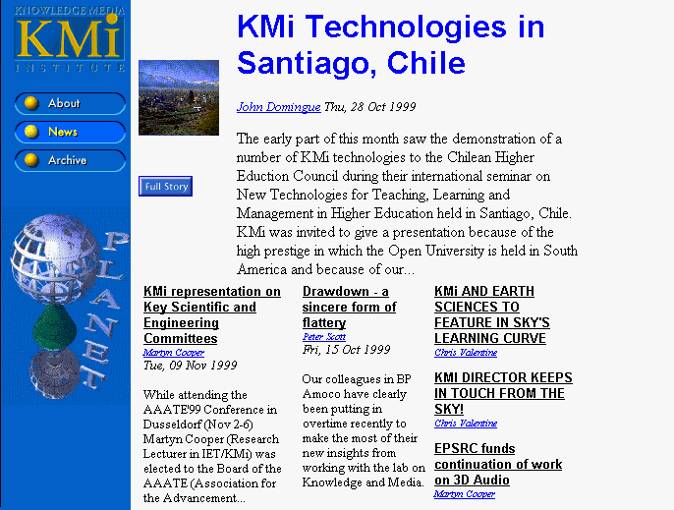
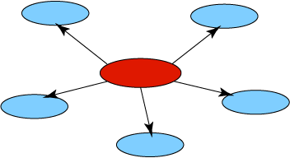
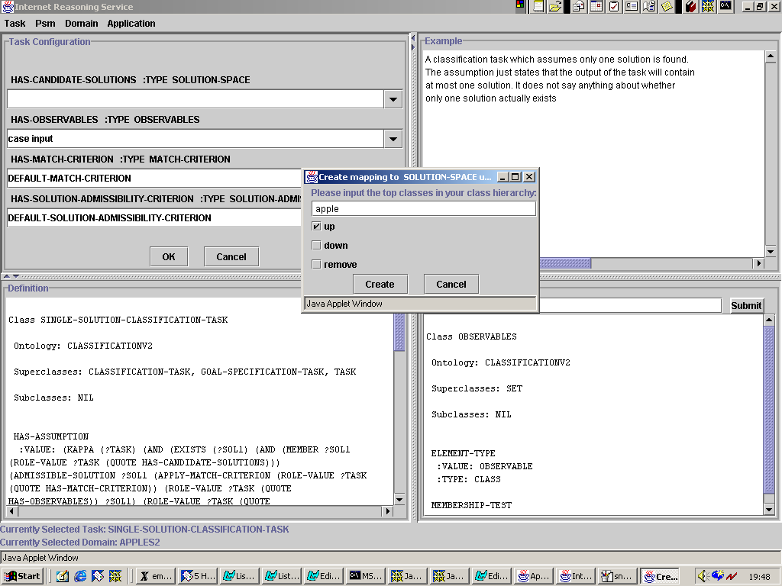
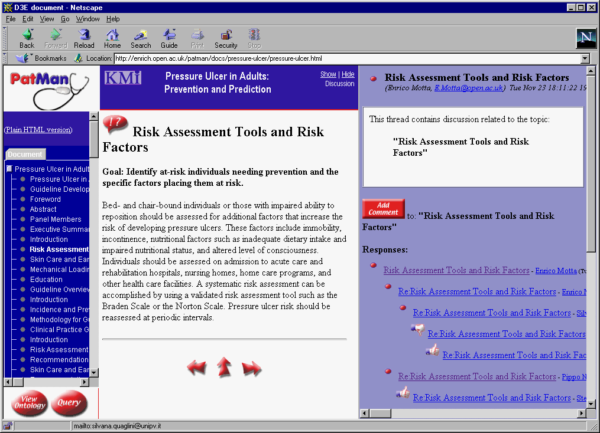
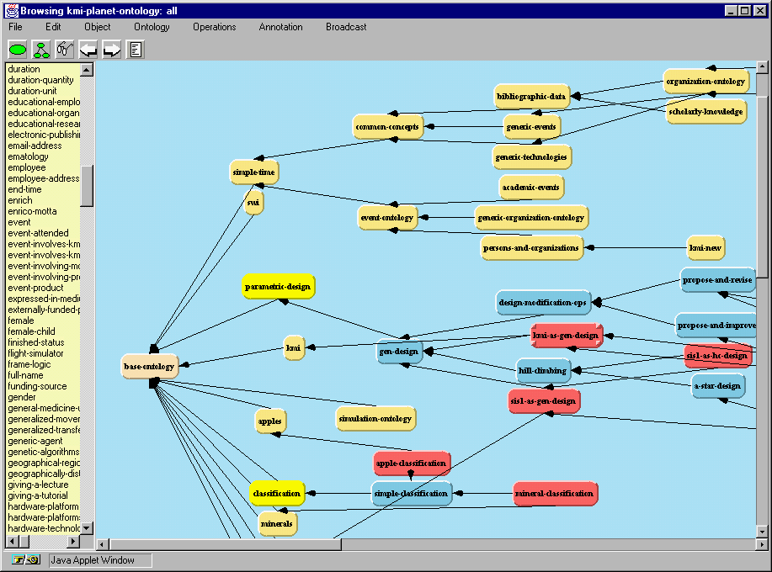
Web-Services
in the Semantic Web Context
Vagan Terziyan
Industrial Ontologies Group
University of Jyvaskyla

Slide 2

The Web Services Stack
Wire Protocol
Description
Discovery
SOAP
WSDL
Registry (UDDI)
provides a standard, flexible way to discover where a Web service is located and where to find more information about what the Web service does
provides a standard, flexible communications channel
provides a standard, flexible way to describe what and how a Web service does what it does
interoperability at the lowest level
interoperability at the content level
dynamic discovery

Slide 3
The General Vision
Bringing the web to its full potential
Web Services
Intelligent Web
Services
Dynamic
UDDI, WSDL, SOAP
WWW
Semantic Web
Static
URI, HTML, HTTP
RDF, RDF(S), OWL

Slide 4
Web Services
Web Services will transform the web from a collection of information into a distributed device of computation.
Web services should transform eCommerce from a nice application into a mass phenomena.
Bringing E-commerce to its full potential requires a Peer-to-Peer (P2P) approach. Anybody must be able to trade and negotiate with everybody else.
However, such an open and flexible E-commerce has to deal with many obstacles before it becomes reality

Slide 5



Web Services
Def 2. New concept for eWork and eCommerce
Def 3.
New programming technology
Def 1. Software Architecture

Slide 6
Web Services
Def 1. Web Services as a Software Architecture
“Web services are a new breed of Web application. They are self-contained, self-describing, modular applications that can be published, located, and invoked across the Web. Web services perform functions, which can be anything from simple requests to complicated business processes. …
Once a Web service is deployed, other applications (and other Web services) can discover and invoke the deployed service.”
IBM web service tutorial

Slide 7
Web Services
➔ Web Services connect computers and devices with each other using the Internet to exchange data and combine data in new ways.
➔ The key to Web Services is on-the-fly software creation through the use of loosely coupled, reusable software components.
➔ Software can be delivered and paid for as fluid streams of services as opposed to packaged products.

Slide 8
Web Services
Business services can be completely decentralized and distributed over the Internet and accessed by a wide variety of communications devices.
The internet will become a global common platform where organizations and individuals communicate among each other to carry out various commercial activities and to provide value-added services.
The dynamic enterprise and dynamic value chains become achievable and may be even mandatory.

Slide 9
Web Services
The web is organized around URIs, HTML, and HTTP.
URIs provide defined ids to refer to elements on the web,
HTML provides a standardized way to describe document structures (allowing browsers to render information for the human reader), and
HTTP defines a protocol to retrieve information from the web.
==> Not surprisingly, web services require a similar infrastructure around UDDI, WSDL, and SOAP.

Slide 10
Web Services
UDDI
WSDL
SOAP
URI
HTML
HTTP

Slide 11
Web Services
UDDI provides a mechanism for clients to find web services.
WSDL defines services as collections of network endpoints or ports. A port is defined by associating a network address with a binding; a collection of ports define a service.
SOAP is a message layout specification that defines a uniform way of passing XML-encoded data. SOAP is basically a technology to allow for “RPC over the web”.

Slide 12
Web Services
Many organizations had the insight that message definition and exchange are not sufficient to build an expressive web services infrastructure.
In addition to UDDI, WSDL and SOAP, standards are proposed such as WSFL, XLANG, ebXML, BPSS, BPML, WSCL, and BPEL4WS.

Slide 13
WSFL (IBM)
The Web Services Flow Language (WSFL) is an XML language for the description of Web Services compositions. WSFL considers two types of compositions:
  resulting composition describes how to achieve a particular business goal;
  result is a description of the overall partner interactions.

Slide 14
XLANG (Microsoft)
The goal of XLANG is to make it possible to formally specify business processes to show not only the behavior of each participant, but the way these behaviors match to produce the overall process. Specific features are:
  Sequential and parallel control flow constructs
  Long running transactions with compensation
  Custom correlation of messages
  Flexible handling of internal and external exceptions
  Modular Behavior Description
  Dynamic service referral
  Multi-role contracts

Slide 15
ebXML, BPSS, BPML (Oasis)
ebXML provides companies with a standard method to exchange business messages, conduct trading relationships, communicate data in common terms and define and register business processes.
Business Process Specification Schema (BPSS) is a standard framework by which business systems may be configured to support execution of business collaborations consisting of business transactions.
The Business Process Modeling Language (BPML) is a meta-language for the modeling of business processes. BPML provides an abstracted execution model for collaborative & transactional business processes based on the concept of a transactional finite-state machine.

Slide 16
WSCL (Hewlett Packard)
Web Services Conversation Language (WSCL) allows the abstract interfaces of Web services WSCL specifies the XML documents being exchanged, and the allowed sequencing of the exchanges. WSCL conversation definitions are themselves XML documents and can therefore be interpreted by Web services infrastructures and development tools. WSCL may be used in conjunction with other service description languages like WSDL; for example, to provide protocol binding information for abstract interfaces, or to specify the abstract interfaces supported by a concrete service.

Slide 17
BPEL4WS (IBM, Microsoft, BEA,...)
BPEL4WS provides a language for the formal specification of business processes and business interaction protocols. By doing so, it extends the Web Services interaction model and enables it to support business transactions. BPEL4WS defines an interoperable integration model that should facilitate the expansion of automated process integration in both the intra-corporate and the business-to-business spaces. BPEL4WS is layered on top of several XML specifications: WSDL 1.1, XML Schema 1.0, and XPath1.0.

Slide 18
Limitations
Recent initiatives enable automated Web service execution, but not automated Web service discovery. Without automated discovery, the service provider is responsible for choosing service partners (remote components) a priori and preconcerting them into an effective unit. Because partner services are chosen prior to receiving the user’s request, the system cannot customize partner selection for the user’s specific needs or preferences.
Bringing web services to their full potential requires their combination with Semantic Web technology.

Slide 19
Semantic Web Services
Imagine a travelling service:
Decompose into elementary services
Describe elementary services by goals instead of hardwiring them.
Keep the human programmer out of the loop to keep it economic, on demand, and scalable.
You cannot achieve this vision without semantic web technology that maintains selection and combination of heterogeneous web services during runtime.

Slide 20
Semantic Web Services
Mechanized support is needed in finding and comparing vendors and their offers. Machine processable semantics of information allows to mechanize these tasks.
Mechanized support is needed in dealing with numerous and heterogeneous data formats. Ontology technology is required to define such standards better and to map between them.
Mechanized support is needed in dealing with numerous and heterogeneous business logics. Mediation is needed to compensate these differences, allowing partners to cooperate properly.

Slide 21
Why Semantic Web Services?
Process description
+
Automatic service discovery
+
Automatic service composition
+
Automatic service execution
=
  DYNAMIC + SCALABLE + REUSABLE
  INTEGRATION

Slide 22

Semantic Markup for Web Services
OWL-S

Slide 23
What is OWL-S?
Formerly it was DAML-S: A DARPA Agent Markup Language for Services
OWL Ontology for (Web) services
AI-inspired markup language:
  tailored to the representational needs of Services
  expressive power
  well-defined semantics
  ontologies support reuse, mapping, markup, ...
Release of OWL-S version 1.0 November, 2003
http://www.daml.org/services/

Slide 24
OWL-S Objectives
Provides an upper ontology for describing properties & capabilities of (Web) services:
  enables automation of service use by agents
  enables reasoning about service properties and capabilities
Notes:
DAML-S is joint work with Stanford, CMU, BBN, Nokia (see last slide).

Slide 25
What Web Service is?
Any Web-accessible program, sensor, device, or even human that is declared as a service will be regarded as a Web service.

Slide 26
Automatic Web Service Discovery
Involves the automatic location of Web services that provide a particular service.
Currently, this task must be performed by a human who uses a search engine to find a service, read the Web page, and execute the service manually.
With OWL-S markup of services, the information necessary for Web service discovery could be specified so that ontology-enhanced (semantic) search engine will locate the services automatically.
Alternatively, a server could proactively advertise itself in OWL-S with a service registry so that requesters can find it when they query the registry.

Slide 27

Service functionality description
This is what I provide
I want to buy “Das Kapital”
And pay by Credit Card
This is what I provide
This is what I provide
And I want to receive it at home
How to express “what”?
…
Match?
How to express the request?

Slide 28
Automatic Web Service Invocation
Involves the automatic execution of a Web service by a computer program or agent.
Currently, a user must go to the service Web site, fill out a form, and click to execute the service (or send a direct HTTP request with the appropriate parameters in HTML).
With OWL-S, execution of a Web service is a collection of function calls. OWL-S provides a declarative, computer-interpretable API for executing these calls. A software agent should be able to interpret the markup to understand what input is necessary to the service call, what information will be returned, and how to execute the service automatically.
Thus, OWL-S must provide declarative APIs for Web services that are necessary for automated Web service execution.

Slide 29
Automatic Web Service Composition (and Interoperation)
Involves the automatic selection, composition, and interoperation of Web services to perform some task, given a high-level description of an objective.
Currently, the user must select the Web services, specify the composition manually, and make sure that any software needed for the interoperation is custom-created.
With OWL-S markup of Web services, the information necessary to select and compose services will be encoded at the service Web sites. Software can be written to manipulate these representations, together with a specification of the objectives of the task, to achieve the task automatically.
Thus, OWL-S must provide declarative specifications of the prerequisites and consequences of individual service use that are necessary for automatic service composition and interoperation.

Slide 30
Automatic Web Service Execution Monitoring
Individual and composed services often require some time to execute completely. A user may want to know during this period what the status of the request is, or plans may have changed, thus requiring alterations in the actions the software agent takes.
Thus, OWL-S should provide declarative descriptors for the state of execution of services.

Slide 31
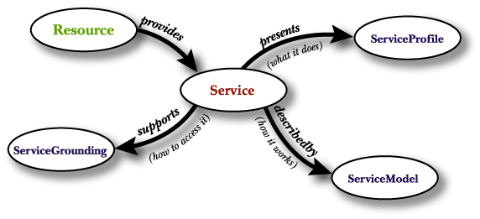
Upper Ontology of Services
A Service is a kind-of Resource in the Web, i.e. some Web resources provide services.
What does the service require of the user, or other agents, and provides for them? The answer to this question is in ServiceProfile
How does it work?
    The answer to this question is in ServiceModel
How is it used?
The answer to this question is in ServiceGrounding.

Slide 32
Service Provides some Function
x₁: movie_name;
x₂: time;
x₃: number_of_tickets;
x₄: seats preference;
x₅: money
G
X
1: takes x1, x2, x3, x4;
2: checks availability of x3 tickets for the x1 movie, at x2 time, which suits x4 constraint ;
3: finds one_ticket_prise from the price list;
4: calculates price for x3 tickets: price = one_seet_price * x3;
5: takes x5;
6: calculates y2 ( y2 = x5 – price );
7: gives y1, y2.
F
1: cinema address;
2: cinema movie schedule;
3: cinema cash-desk location;
4: nock to the cash-desk window and, when it opens, make your order (X)
Y
y₁: movie tickets;
y₂: change

Slide 33
Service Provides some Function
G
X
Service Model
Service Grounding
F
Service Profile
Y

Slide 34
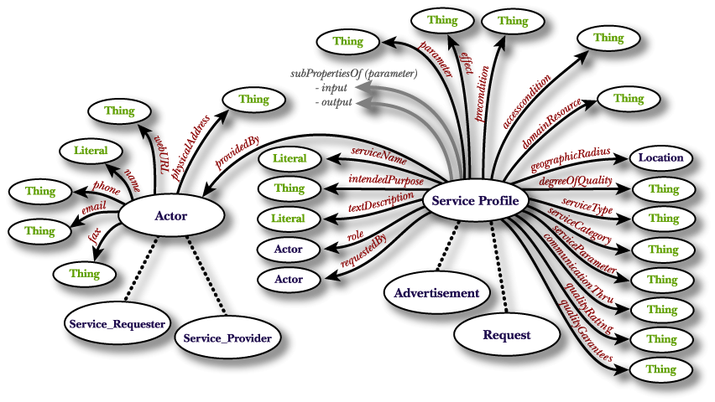
Service Profile

Slide 35
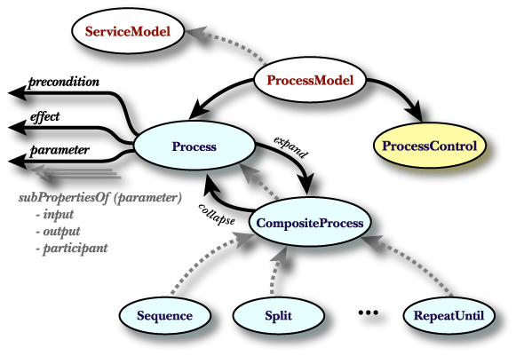
Service Model

Slide 36
Web-Services Choreography
Web Services Choreography concerns the observable interactions of services with their users. Any user of a Web Service, automated or otherwise, is a client of that service. These users may, in turn, be other Web Services, applications or human beings.
A choreography description is a multi-party contract that describes the external observable behavior across multiple clients (services) in which external observable behavior is defined as the presence or absence of messages that are exchanged between a Web Service and it's clients.

Slide 37
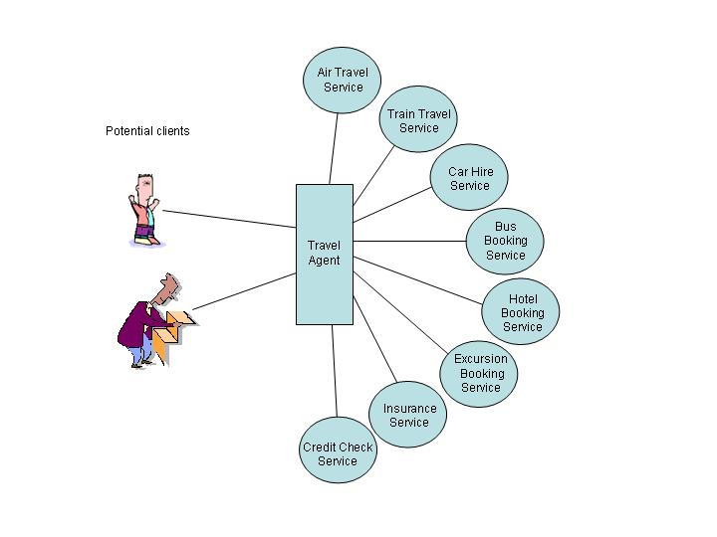
Web-Services Choreography

Slide 38
Web-Services Choreography
Web Services Choreography Requirements
W3C Working Draft 11 March 2004
http://www.w3.org/TR/2004/WD-ws-chor-reqs-20040311/
As the momentum around Web Services grows, the need for effective mechanisms to co-ordinate the interactions among Web Services and their users becomes more pressing. The Web Services Choreography Working Group has been tasked with the development of such a mechanism in an interoperable way.

Slide 39
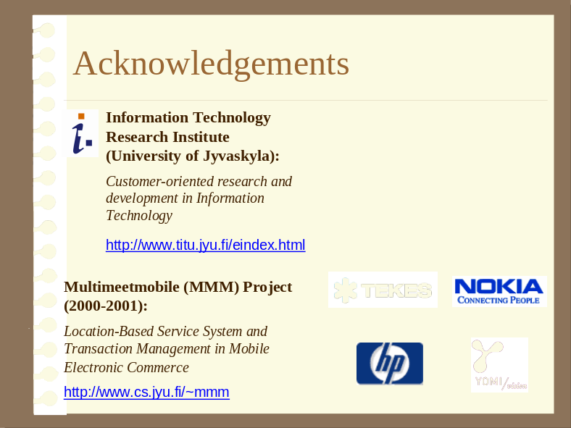
Ontology-Based Transaction Management
Terziyan V., Ontological Modelling of E-Services to Ensure Appropriate Mobile Transactions, In: International Journal of Intelligent Systems in Accounting, Finance and Management, J. Wiley & Sons, Vol. 11, No.3, 2002, pp. 159-172.
Terziyan V., Veijalainen J., M-Commerce Transaction Model Implementation at a Mobile Terminal, Multimeetmobile Project Report, TITU, University of Jyvaskyla, April 2001.

Slide 40
Ontology-Based Client-Side Transaction Monitor
The ontology-based framework for transaction management was used so that the Transaction Monitor was able to manage transaction across multiple Web-services.

Slide 41
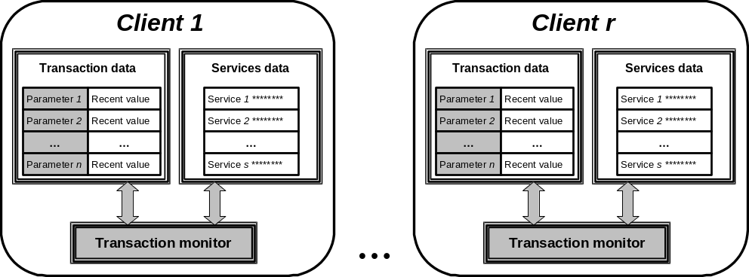
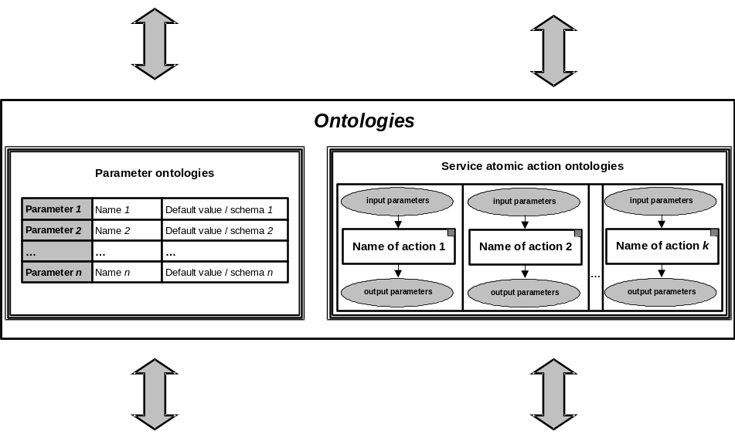
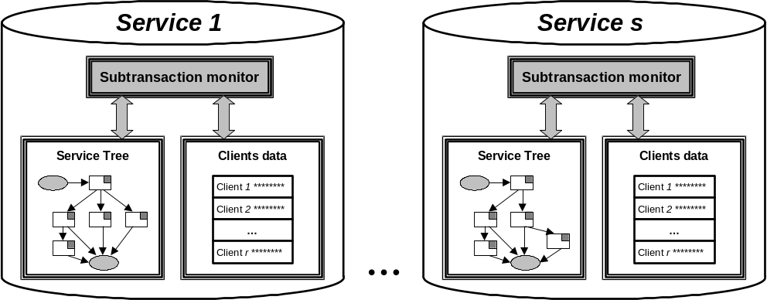
The conceptual scheme of the ontology-based transaction management

Slide 42
Action, Subtransaction, Transaction
Let an action be a single client-server query-response session between a client and a service provider
Subtransaction is a vector of one or more actions between a terminal and a service managed by the service with definitely stated final goal and common memory of parameters.
Transaction is a vector of one or more subtransactions with the same client and possibly different services managed by the client, with definitely stated final goal and common memory of parameters.

Slide 43
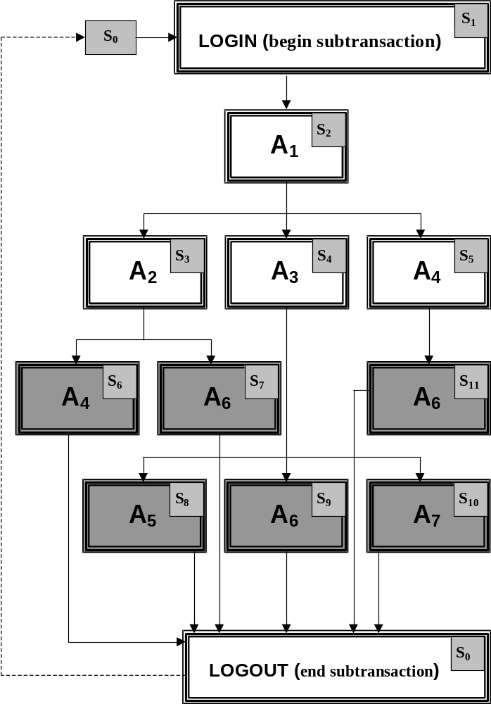
Service Tree
Service tree is a tree-like structure of the set of subtransactions, which a service can offer to his clients and which is used by a service to manage subtransactions with clients. Action of interest, toned for every subtransaction in the service tree is such an action, which outcome is in particular interest of a customer and has an economic value.
Service tree as a collection of subtransactions offered by the Service to its customers. In the rectangles together with the Id of an action there is also Id of a state, into which a subtransaction is coming after performing this action

Slide 44
Constants and Ontologies
basic constants, which define Ids of the terminal and services used, basic screens for the interface, total numbers of services, actions and parameters, which Transaction Monitor is operating with;
service atomic actions ontologies define basic actions with their input and output, from which every service can be composed, and which are used as a common procedural language between a client and a service (include always LOGIN and LOGOUT actions ontologies);
parameter ontologies describe parameters, which can be used in actions, by providing their Ids, default values and types (or schemas), and which are actually a common declarative language between a client and a service.

Slide 45
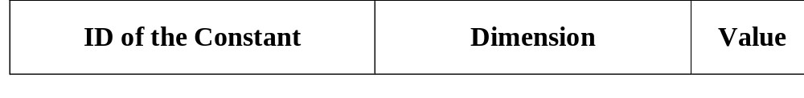
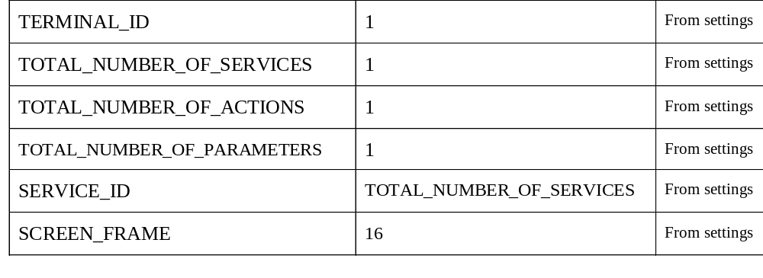
Basic constants

Slide 46
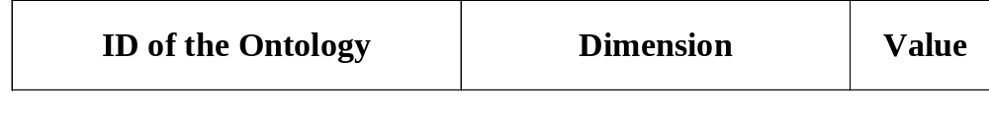
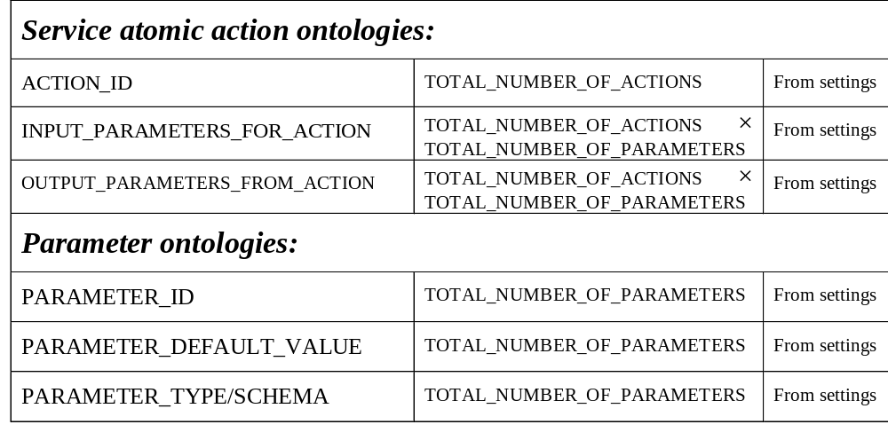
Ontologies

Slide 47
Variables
control variables have sense only for a Transaction Monitor and are used to manage different states of the terminal during going-on transactions, subtransactions and actions;
working variables are used to manage parameters' states and provide common memory for different subtransactions, which can be run with different services;
billing variables are used to manage billing data in the Transaction Monitor. The terminal will collect bills separately for every service adding online price for appropriate service actions to it, when it is requested.

Slide 48
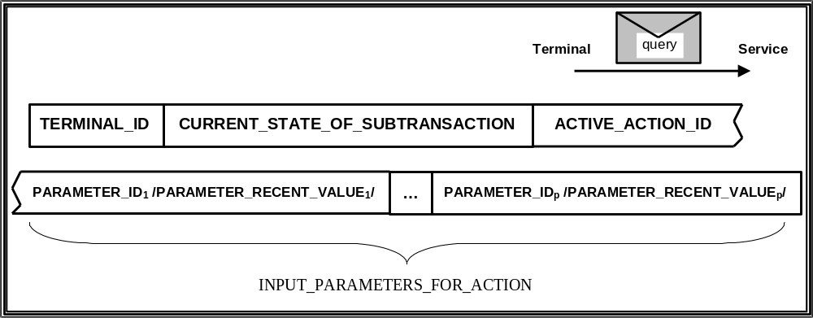
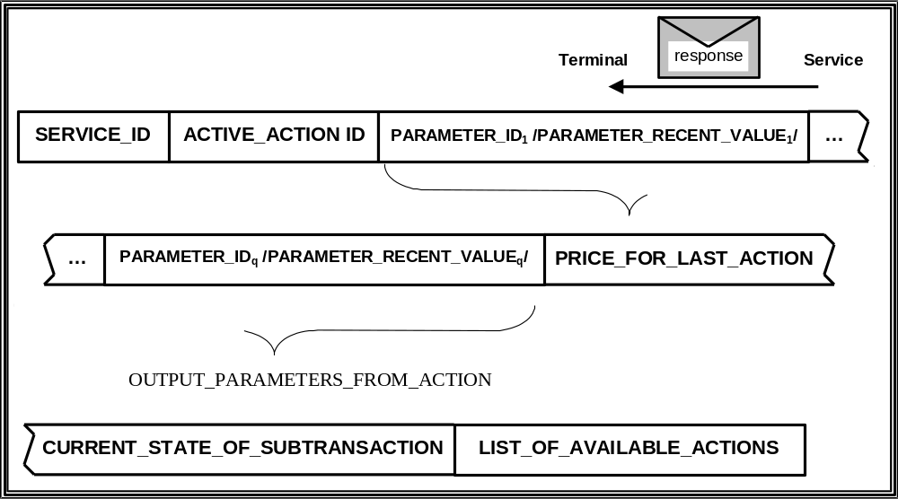
Service Actions
service query
service response

Slide 49
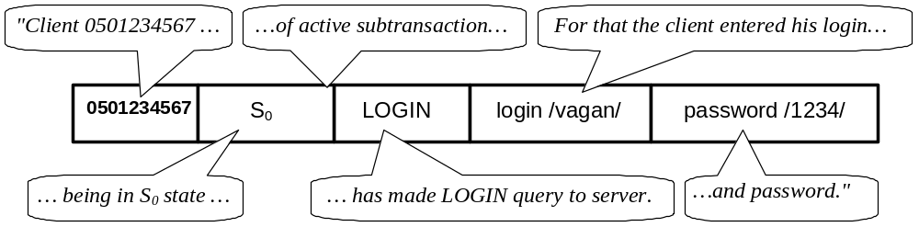
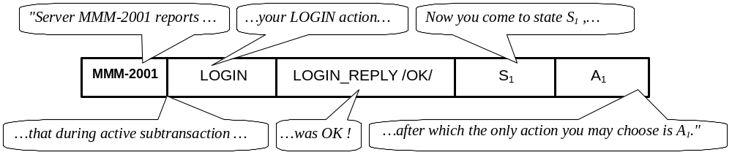
An Example of Action

Slide 50
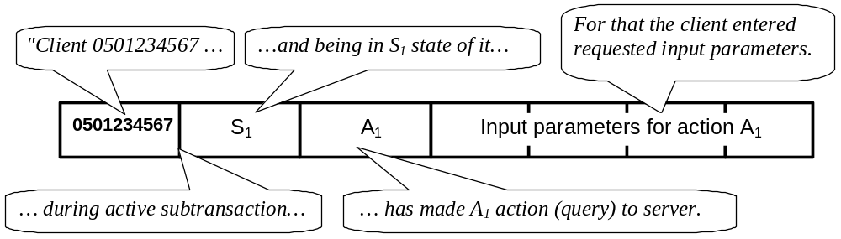
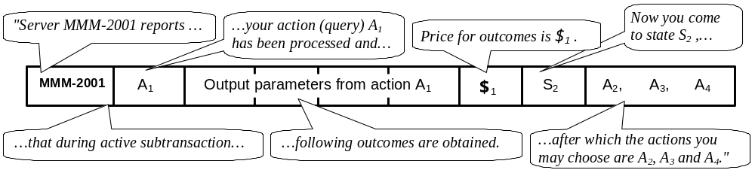
An Example of Action

Slide 51
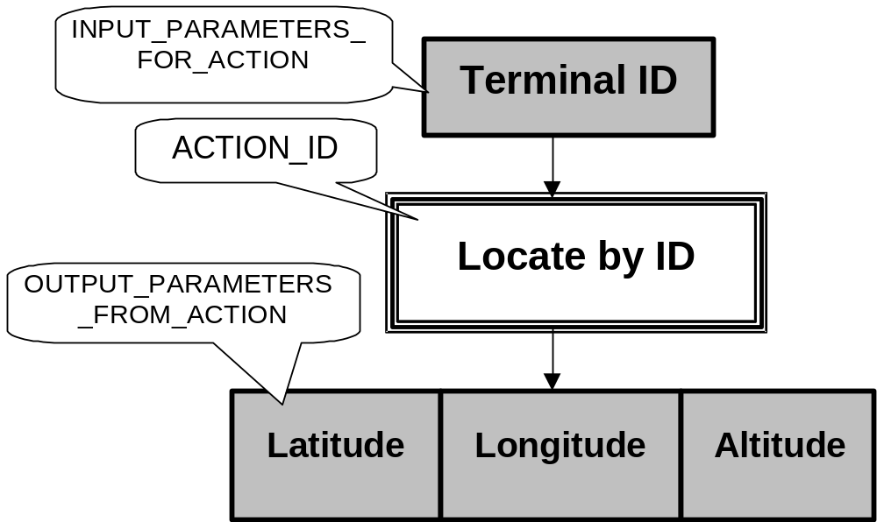
LBS example: ontology for the LOCATE_BY_ID action

Slide 52
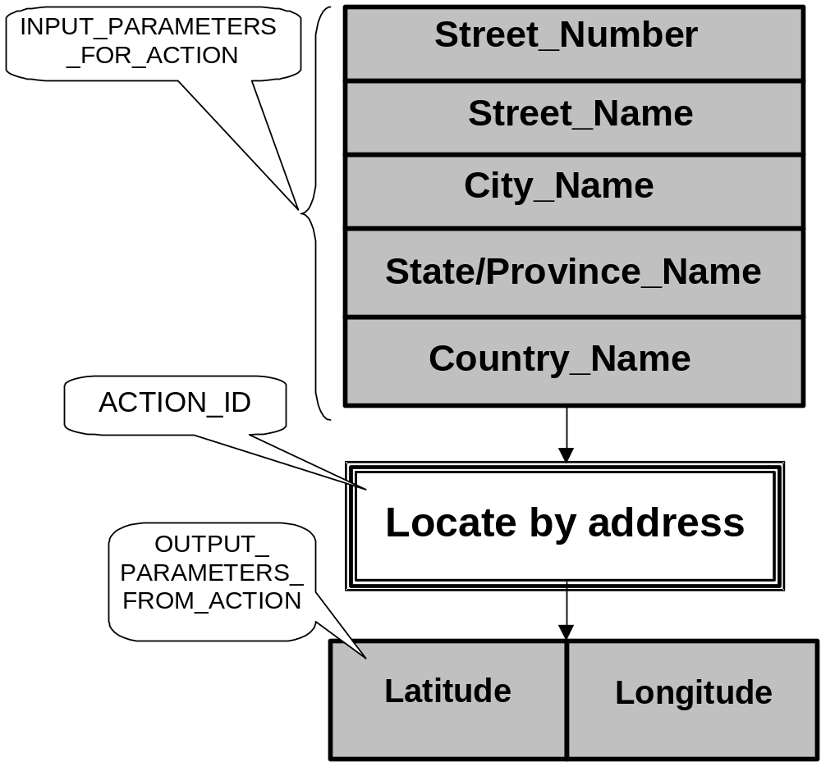
LBS example: ontology for the LOCATE_BY_ADDRESS action

Slide 53
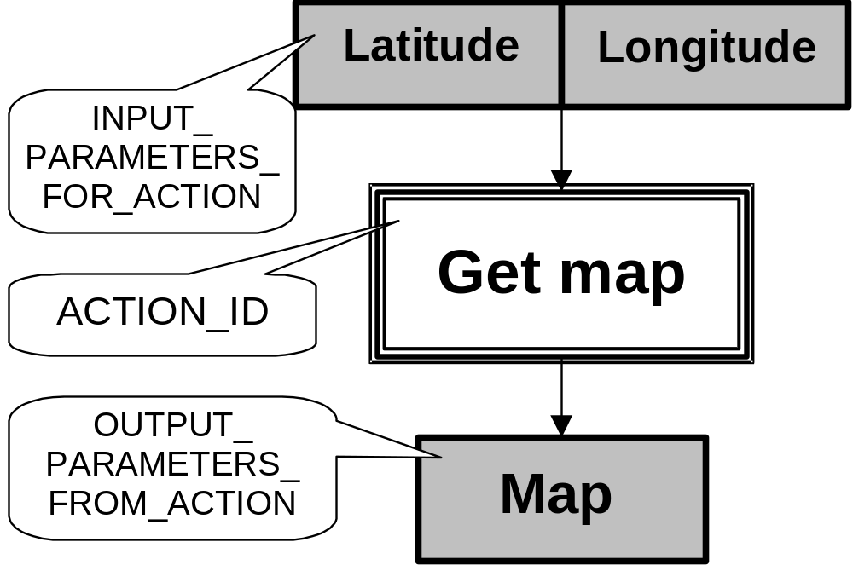
LBS example: ontology for the GET_MAP action

Slide 54
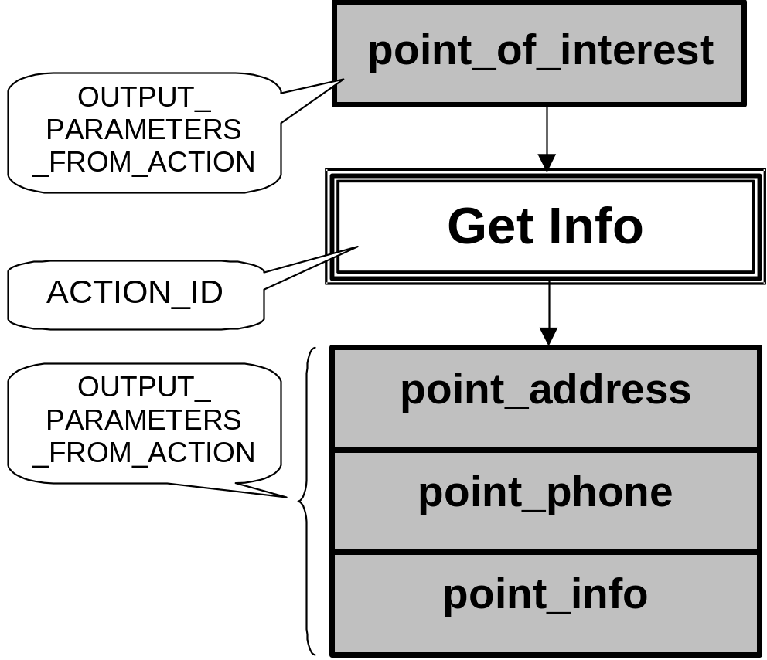
LBS example: ontology for the GET_INFO action

Slide 55
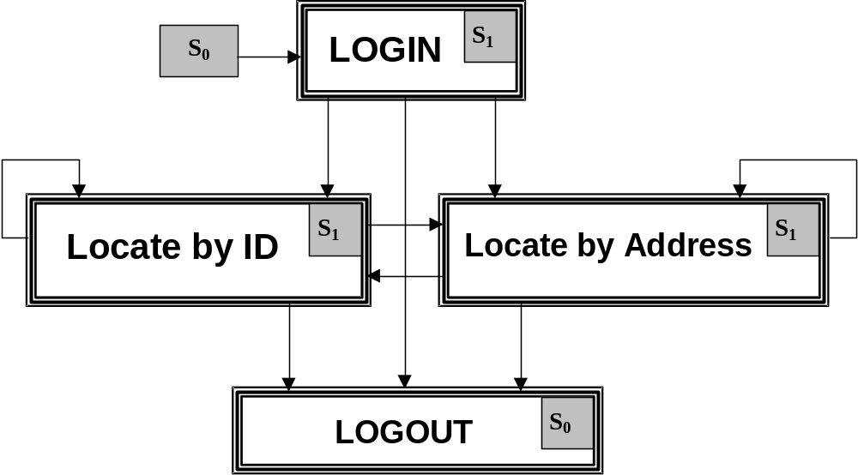
LBS example: service tree for the Positioning Service

Slide 56
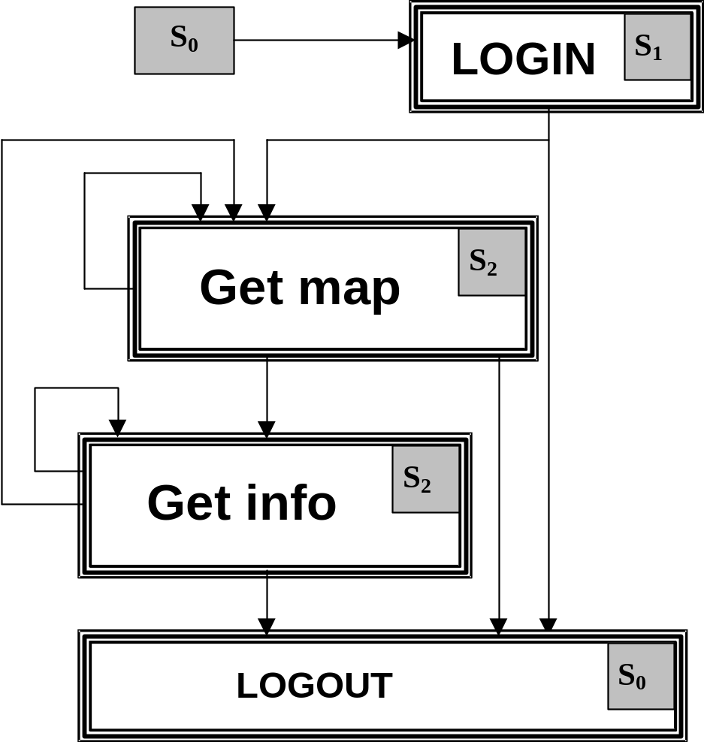
LBS example: service tree for the Location Based Service

Slide 57
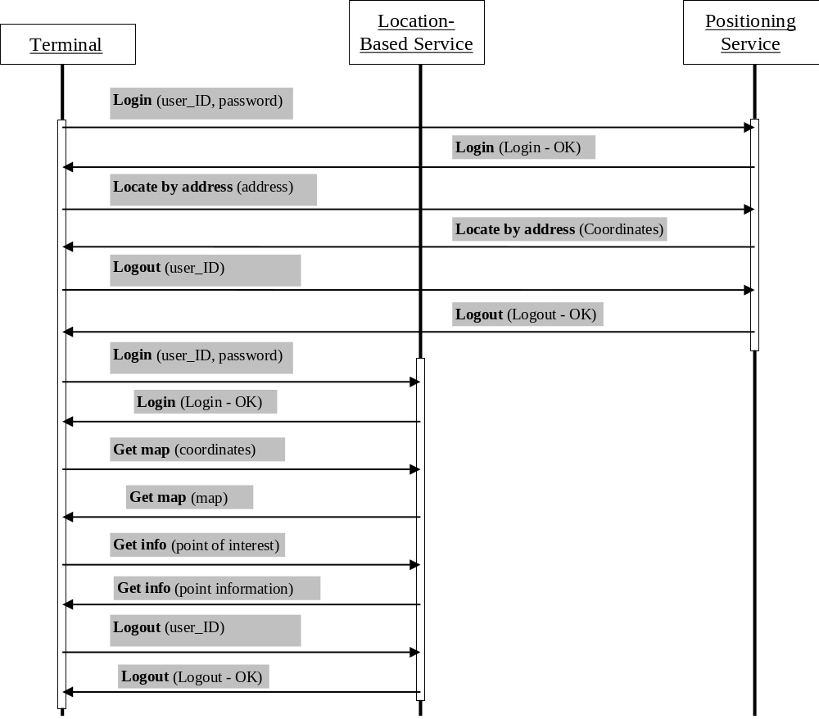
LBS example: Case when a user locates himself and submits coordinates to LBS

Slide 58

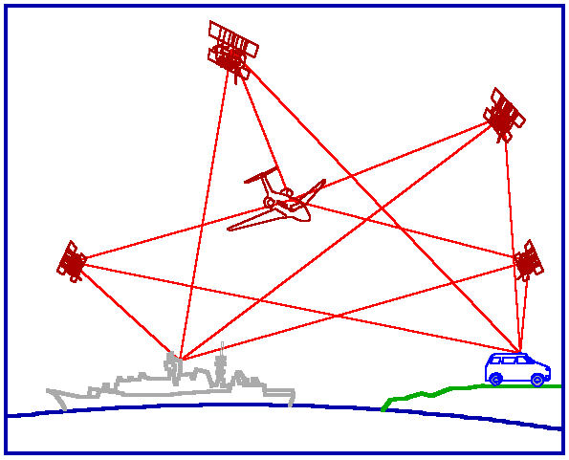
<Query
Query_ID="01-03-2002_12:33:57"
Type="Service"
To_Service="Positioning_Service"
From_Terminal="0501234567"
Terminal_State="S0"
>
<Action ID="LOGIN"/>
<Input_Parameters>
<Parameter ID="user_ID” Type="text” Value="vagan"/>
<Parameter ID="password” Type="text” Value="4321"/>
</Input_Parameters>
</Query>
“Login” Query
Terminal
Positioning Service

Slide 59
<Response
Response_ID="01-03-2002_12:34:42” Type="Service” To_Query="01-03-2002_12:33:57”
To_Terminal="0501234567” From_Service="Positioning_Service” Terminal_State="S1"
>
<Action ID="LOGIN"/>
<Output_Parameters>
<Parameter ID="login_reply” Type="binary” Value="OK"/>
</Output_Parameters>
<Price_for_Action Currency="EURO" Value="0.0"/>
<Bill_Recent_Value Currency="EURO" Value="0.0"/>
<Actions_Allowed>
<Action ID="LOGOUT"/>
<Action ID="LOCATE_BY_ID"/>
<Action ID="LOCATE_BY_ADDRESS"/>
</Actions_Allowed >
</Response>
“Login” Response
Terminal
Positioning Service

Slide 60
<Query
Query_ID="01-03-2002_12:34:53"
Type="Service"
To_Service="Positioning_Service"
From_Terminal="0501234567"
Terminal_State="S1"
>
<Action ID="LOCATE_BY_ADDRESS"/>
<Input_Parameters>
<Parameter ID="street_number” Type="integer” Value="43"/>
<Parameter ID="street_name” Type="text” Value="Nokatu"/>
<Parameter ID="city_name" Type="text” Value="Jyvaskyla"/>
<Parameter ID="country_name” Type="text” Value="Finland"/>
</Input_Parameters>
</Query>
“Locate by Address” Query
Terminal
Positioning Service

Slide 61
<Response
Response_ID= "01-03-2002_12:35:14” Type= "Service"
To_Query= "01-03-2002_12:34:53” To_Terminal= "0501234567"
From_Service= "Positioning_Service” Terminal_State= "S1"
>
<Action ID="LOCATE_BY_ADDRESS"/>
<Output_Parameters>
<Parameter ID="latitude" Type="integer" Value="54321"/>
<Parameter ID="longitude" Type="integer" Value="98765"/>
</Output_Parameters>
<Price_for_Action Currency="EURO" Value="0.23"/>
<Bill_Recent_Value Currency="EURO" Value="0.23"/>
<Actions_Allowed>
<Action ID="LOGOUT"/>
<Action ID="LOCATE_BY_ID"/>
<Action ID="LOCATE_BY_ADDRESS"/>
</Actions_Allowed >
</Response>
“Locate by Address” Response
Terminal
Positioning Service

Slide 62
<Query
Query_ID="01-03-2002_12:35:20"
Type="Service"
To_Service="Positioning_Service"
From_Terminal="0501234567"
Terminal_State="S1"
>
<Action ID="LOGOUT"/>
<Input_Parameters>
<Parameter ID="user_ID” Type="text” Value="vagan"/>
</Input_Parameters>
</Query>
“Logout” Query
Terminal
Positioning Service

Slide 63
<Response
Response_ID= "01-03-2002_12:35:25” Type= "Service"
To_Query= "01-03-2002_12:35:20” To_Terminal= "0501234567"
From_Service= "Positioning_Service” Terminal_State= "S0"
>
<Action ID="LOGOUT"/>
<Output_Parameters>
<Parameter ID="logout_reply” Type="binary” Value="OK"/>
</Output_Parameters>
<Price_for_Action Currency="EURO" Value="0.0"/>
<Bill_Recent_Value Currency="EURO" Value="0.23"/>
<Actions_Allowed>
<Action ID="LOGIN"/>
</Actions_Allowed >
</Response>
“Logout” Response
Terminal
Positioning Service

Slide 64
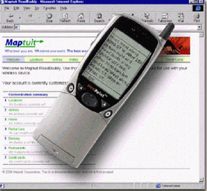
<Query
Query_ID="01-03-2002_12:35:47"
Type="Service"
To_Service="Location_Based_Service"
From_Terminal="0501234567"
Terminal_State="S0"
>
<Action ID="LOGIN"/>
<Input_Parameters>
<Parameter ID="user_ID” Type="text” Value="vagan"/>
<Parameter ID="password” Type="text" Value="1234"/>
</Input_Parameters>
</Query>
“Login” Query
Terminal
Location-Based Service

Slide 65
<Response
Response_ID= "01-03-2002_12:36:01” Type= "Service"
To_Query= "01-03-2002_12:35:47” To_Terminal= "0501234567"
From_Service= "Location_Based_Service” Terminal_State= "S1"
>
<Action ID="LOGIN"/>
<Output_Parameters>
<Parameter ID="login_reply” Type="binary" Value="OK"/>
</Output_Parameters>
<Price_for_Action Currency="USD" Value="0.0"/>
<Bill_Recent_Value Currency="USD" Value="0.0"/>
<Actions_Allowed>
<Action ID="LOGOUT"/>
<Action ID="GET_MAP"/>
</Actions_Allowed >
</Response>
“Login” Response
Terminal
Location-Based Service

Slide 66
<Query
Query_ID="01-03-2002_12:39:07"
Type="Service"
To_Service="Location_Based_Service"
From_Terminal="0501234567"
Terminal_State="S1"
>
<Action ID="GET_MAP"/>
<Input_Parameters>
<Parameter ID= "latitude” Type= "integer” Value="54321"/>
<Parameter ID= "longitude” Type= "integer” Value="98765"/>
</Input_Parameters>
</Query>
“Get Map” Query
Terminal
Location-Based Service

Slide 67
<Response
Response_ID= "01-03-2002_12:41:34” Type= "Service"
To_Query= "01-03-2002_12:39:07” To_Terminal= "0501234567"
From_Service= "Location_Based_Service” Terminal_State= "S2"
>
<Action ID="GET_MAP"/>
<Output_Parameters>
<Parameter ID= "map” Type= "GML” Value= "GML Data"/>
</Output_Parameters>
<Price_for_Action Currency="USD" Value="0.15"/>
<Bill_Recent_Value Currency="USD" Value="0.15"/>
<Actions_Allowed>
<Action ID="LOGOUT"/>
<Action ID="GET_MAP"/>
<Action ID="GET_INFO"/>
</Actions_Allowed >
</Response>
“Get Map” Response
Terminal
Location-Based Service

Slide 68
<Query
Query_ID="01-03-2002_12:50:12"
Type="Service"
To_Service="Location_Based_Service"
From_Terminal="0501234567"
Terminal_State="S2"
>
<Action ID="GET_INFO"/>
<Input_Parameters>
<Parameter ID= "point_of_interest” Type="text” Value="Alba_Hotel"/>
</Input_Parameters>
</Query>
“Get Info” Query
Terminal
Location-Based Service

Slide 69
<Response
Response_ID= "01-03-2002_12:51:04” Type= "Service” To_Query= "01-03-2002_12:50:12"
To_Terminal= "0501234567” From_Service= "Location_Based_Service” Terminal_State= "S2"
>
<Action ID="GET_INFO"/>
<Output_Parameters>
<Parameter ID="point_address" Type="text" Value="Mattilaniemi A1"/>
<Parameter ID="point_phone" Type="text" Value="0509876543"/>
<Parameter ID="point_info” Type="text” Value="Rooms available:
single (60 EURO), double (80 EURO)"/>
</Output_Parameters>
<Price_for_Action Currency="USD" Value="0.10"/>
<Bill_Recent_Value Currency="USD" Value="0.25"/>
<Actions_Allowed>
<Action ID="LOGOUT"/>
<Action ID="GET_MAP"/>
<Action ID="GET_INFO"/>
</Actions_Allowed >
</Response>
“Get Info” Response
Terminal
Location-Based Service

Slide 70
<Query
Query_ID="01-03-2002_12:58:03"
Type="Service"
To_Service="Location-Based_Service"
From_Terminal="0501234567"
Terminal_State="S2"
>
<Action ID="LOGOUT"/>
<Input_Parameters>
<Parameter ID="user_ID” Type="text” Value="vagan"/>
</Input_Parameters>
</Query>
“Logout” Query
Terminal
Location-Based Service

Slide 71
<Response
Response_ID= "01-03-2002_12:58:55” Type= "Service"
To_Query= "01-03-2002_12:35:20” To_Terminal= "0501234567"
From_Service= "Location_Based_Service” Terminal_State= "S0"
>
<Action ID="LOGOUT"/>
<Output_Parameters>
<Parameter ID="logout_reply" Type="binary" Value="OK"/>
</Output_Parameters>
<Price_for_Action Currency= ”USD” Value= "0.0"/>
<Bill_Recent_Value Currency= ”USD” Value= "0.25"/>
<Actions_Allowed>
<Action ID="LOGIN"/>
</Actions_Allowed >
</Response>
“Logout” Response
Terminal
Location-Based Service

Slide 72
Atomicity considerations (J. Veijalainen)
Money atomicity: Money is either entirely transfer or not transfer at all;
Goods atomicity: Customer receives the ordered goods if and only if merchant is paid;
Distributed Purchase Atomicity: Products bought from different suppliers are either both delivered or none.

Slide 73
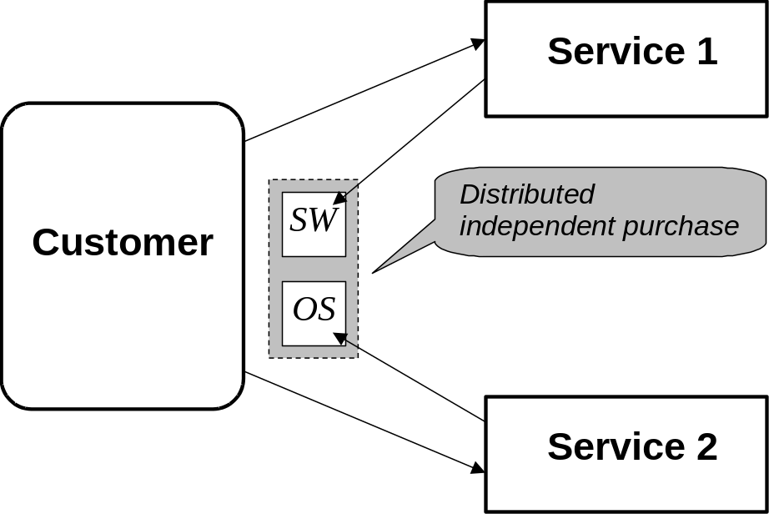
Distributed independent purchase case
Assume a customer wants to purchase specialised software (SW) from a merchant. In order run this software, he also needs an operating system (OS), which is, however, only available from a different merchant. As both goods individually are of no value for the customer, he needs the guarantee to perform the purchase transaction with the two different merchants atomically in order to get either both products or none.

Slide 74
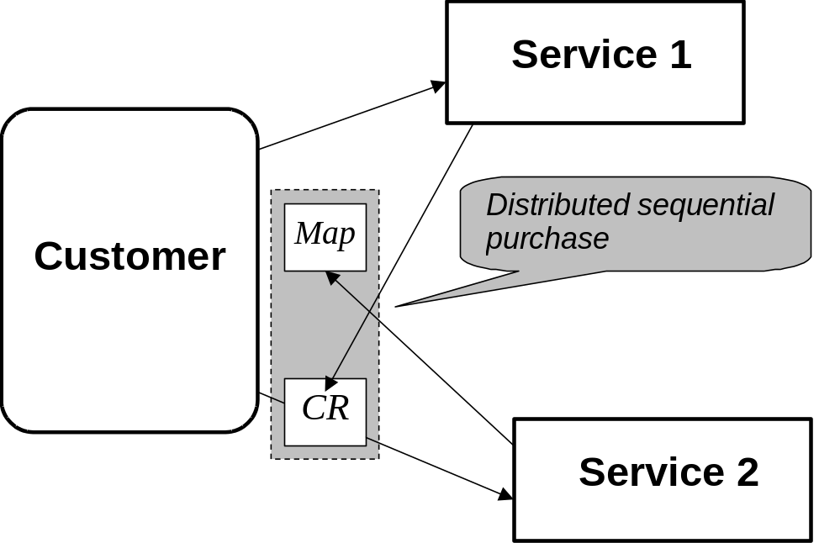
Distributed sequential purchase case
Assume that a customer needs a Map from Service 2 but to apply for that map he is requested to provide his coordinates (CR). Coordinates he can get from Service 1. Assume that Service 1 does not care about how a customer is going to use coordinates delivered - the service has made job and got money for it. Even if the rest of a transaction will fail and for some reason a customer will not get his Map from Service 2, full compensation for the transaction as whole cannot be guaranteed.

Slide 75
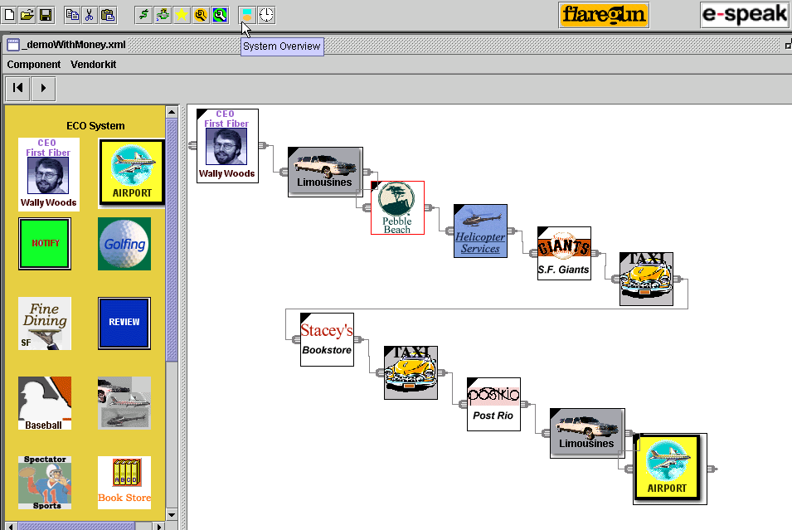

E-Speak Environment for E-Services Integration

Slide 76
Before e-Speak
You want to travel from Singapore to Washington. You want a flight, a car rental (preferably a blue Toyota), a hotel in the Foggy Bottom district of Washington, a tour around the White House, a concert at the Kennedy Centre and medical insurance cover for two weeks. Going the old-fashioned way, you'd have to visit at least a dozen separate Web sites (or make as many phone calls) to find out what's available and get the best deals.

Slide 77
With e-Speak
all you'll need to do is key in the details of your request - as complicated as they may be - and the whole package of services gets delivered to you, within hours. And you're likely to end up buying services from people you've never heard of

Slide 78
Universal ecosystem for global transactions
E-speak provides the ecosystem for the whole sequence of transactions needed for globally distributed services - from service request, to final delivery.

Slide 79
What for?
For a User: e-speak helps consumers looking for services find and connect to service providers
For a Service Provider: e-speak provides the basic building blocks for service creation

Slide 80
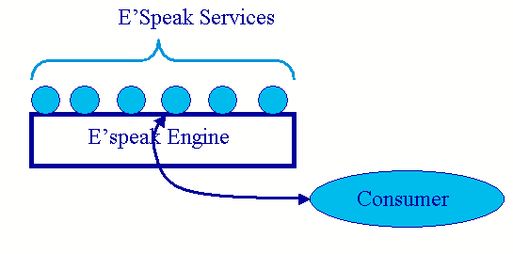
e-Speak is (1) a Component Transaction Monitor

Slide 81
e-Speak is (2) a Distributed Service
Service Provider
Service Provider
E-Speak Engine
E-Speak Engine
Lightweight Directory Access Protocol
Customer
Service Provider
E-Speak Engine

Slide 82
e-Speak is (3) a Service Support Provider
e-Speak is a system that provides support for:
Advertising and finding based on vocabularies
Authentication
Multiple access methods
Security

Slide 83
E-Speak is (4) an Extensible System with Decentralized Control
– Vocabularies
• Attributes and values
• Combined and advertised
–Services
• Atomic level services
• Infrastructure services
• Meta services

Slide 84
Agent-Based Service Composition
Ermolayev V., Keberle N., Plaksin S., Kononenko O., Terziyan V., Towards a Framework for Agent-Enabled Semantic Web Service Composition, International Journal of Web Service Research, Idea Group, ISSN: 1545-7362, Vol. 1, No. 3 , 2004, pp. 63-87.

Slide 85
Semantic Web Services’ Orchestration: the field is becoming increasingly hot
Several ongoing initiatives define compositional notations for web services
Such notations express the flow of control
and data across a collection of web services
whose choreography performs a workflow
Notes:
The point is that the ongoing initiatives mainly focus on the descriptive instruments for WS orchestration

Slide 86
…Having a Recipe doesn’t yet Grant Having a Meal…
A pro-active component is required
Pro-active understanding of the process specification is:
  Not only the ability to ensure the right sequence and the proper combination of the components
  But also the capability to find the best provider
  in the dynamic and open environment
This is why much attention is paid to the field
of agent-enabled web service composition
Notes:
This is another dimension – complementary to the languages providing WS compositional notation.
Why agents? – An agent paradigm is natural to use for implementing pro-active behavior. The next slide justifies it.

Slide 87
What should be offered is:
A new understanding of a web service as:
  An agent capability implemented as a self-contained pro-active software component which behaves to increase its utility and is the subject of negotiation and trade
Example:
    A service requested from a travel agency is
    ‘BookRoundtrip(‘Kiev’, ‘Erfurt’, 22/09/03, 25/09/03, …)’, the price paid by the requestor will comprise:
      the prices of consumable resources (air fare, hotel room, …)
      plus the incentive paid to the contracted service provider
      for ‘BookRoundtrip’ service usage
Notes:
The offer is to introduce an intelligent, rational, pro-active and autonomous software service provider for another artificial and human service consumers.

Slide 88
What’s behind the scenes …
The agent performing ‘BookRoundtrip’ service should be able to realize
that the requested task is composite
and will require RATIONAL cooperation
with at least:
  Air Companies’ service providing agents
  And hotel booking service providing agents
These actors will also intend to increase their own utilities by requesting fees for their service provision
Notes:
Ultimately – the composition of a service is behind the scenes. A service consumer is normally not interested to behold how the meal is cooked and what are the ingredients. His/her perception of a service is that the thing is the atomic consumable.
…each of the freelance sub-contractors might have its own unique and exotic kitchen for the service it provides …

Slide 89
‘BookRoundtrip’ Scenario
Agent roles (played by human actors):
AUTHOR (A) – acts on behalf of the one of the paper authors attending ICWS’03-Europe , requests ‘BookRoundtrip’ service
TRAVEL AGENT (T) –provides ‘BookRoundtrip’ service, generates and conducts corresponding task execution behind the scenes
FARE AGENT (F) – provides air fare information
and booking services
ICWS INFO (I) – provides information services
on ICWS’03-Europe: local arrangements, infrastructure, accommodation, etc
HOTEL AGENT (H) – provides hotel room reservation services
BUSINESS PARTNER (P) – acts on behalf of A’s business partner in Austria with whom A intends to meet in Germany in time of the conference to discuss a joint proposal
Notes:
We have tried to study the features of a service orchestration process – i. e., how the parts of the meal are cooked by different contractors by their own capabilities.
The case was the ‘BookRoundTrip’ Scenario

Slide 90

‘BookRoundtrip’ Exercise Inputs
Semi-formally (enough for human actors
to understand unambiguously):
Starting_Point= “Kiev, Ukraine”
Destination=“Erfurt, Germany”
Beg_Date=22/09/2003
End_Date=25/09/2003
Event=“ICWS’03-Europe”
Preferences=(“low fare”, “non-stop flights”, “fast connections”, “4-star hotel”, “continental breakfast”, “conference discounts”)
Constraints=(Budget = €1500, Payment=(VISA, USD),
Hotel >= 3-star, Room-per-night <= €110, Hotel_Location=”in Max 20 min walk from the Conference venue”)
Special_Arrangements=((Event=“business dinner”,
Agent=(“Prof. Heinrich C. Mayr”, http://www.ifi.uni- klu.ac.at/IWAS/HM/Staff/Heinrich.Mayr/),
Date=(23/09/2003, 24/09/2003),
Location=(Erfurt, Munich)),…)
A
Notes:
These are just the inputs comprising the preferences and the constraints. Please also note that the inputs require the nested service: ‘Business dinner’ is a separate planning task in frame of the ‘BookRoundtrip’. Even A user understands this complexity.
However, the further journey behind the scenes will show that the service is far more complex in “cooking”

Slide 91

What are the parties supposed to do?
Negotiates with T-s about which A believes that they are:
  Capable to provide ‘BookRoundtrip’
  Reliable partners
Collects proposals from T-s and selects the best of them
Hires the T which has given the best proposal
Pays and gets the results
Analyses if A’s inputs allow
to accept the job
Prepares the proposal based
on its previous experience
IF hired:
  Conducts the performance
  of ‘BookRoundtrip’ according to:
    Its knowledge about the job
    Its beliefs about the other service providers which might be involved
  Provides the best result possible
  to prove that it is reliable
  But does it rationally for not
  to loose its income
A
T

Slide 92
Why parties do what they do?
A desires:
Not to go behind the scenes
To rely on the T-s competencies
To pay a reasonable incentive for that
T desires:
To be hired and paid
for the job
To spend the money most efficiently (remain competitive)
To remain a reliable partner for A
A believes:
  ‘BookRoundtrip’ is an atomic activity – just
  a piece of cake
  ‘BookRoundtrip’ may be outsourced to T
T believes:
  ‘BookRoundtrip’
  is a complex, dynamic, composite task
Notes:
And these are the mental states of a consumer and a provider

Slide 93
T: ‘BookRoundtrip’ is a Complex Task
The knowledgebase of T contains facts:
  BookRoundtrip is a Task
  It contains at least PlanTrip Task and MakeHotelRes, ApplyForVisa, SpecArrangements Activities as its phases
  MakeHotelRes requires PlanTrip results as the PreCondition
  SpecArrangements and ApplyForVisa may be performed concurrently
  with PlanTrip and
  MakeHotelRes
These facts are formulated in the terms of the Task Ontology (namespace
for the compositional notation)
Task
Part_of
Activity
Book
Roundtrip
Is_a
Is_a
Is_a
Part_of
HasPrecond
Part_of
Part_of
Make
HotelRes
PlanTrip
Spec
Arrangements
ApplyForVisa
HasPrecond
PlanTrip
Results
Approved
Individual_of
PreCondition
!!! Another T may have a different idea of ‘BookRoundTrip’ composition
Notes:
Why T believes ‘BookRoundtrip’ to be complex?
A nice fact is that all these facts may be formulated in OWL and in the terms of our Task Ontology

Slide 94
T: ‘BookRoundtrip’ – More Facts
The knowledgebase of T contains facts:
  Tasks and Activities have Partial Local Plans (PLP)
  PLPs among other facts define the Capability
  to perform an Activity either by itself or by outsourcing it to another agent
  According to PlanTripPLP
  T is capable to perform PlanTrip by itself
  According to MakeHotelResPLP
  T needs to outsource MakeHotelRes to another agent (via Contract Net negotiation)
Partial
Local
Plan
Task
HasPLP
Is_a
Activity
HasPLP
PlanTripPLP
PlanTrip
Is_a
CapableTo
Make
HotelRes
HasPLP
DefineCapability
Make
HotelRes
PLP
Self-
Performance
Individual_of
CapableTo
Individual_of
Capability
Outsource
!!! Another T may have different
Capabilities and PLPs wrt ‘BookRoundTrip’phases
Notes:
The Task Ontology provides the frame to specify more facts about the structure and the performers of ‘BookRoundtrip’ activities.

Slide 95
T: behaves pro-actively
– Adjusts Inputs
An intelligent service provider may propose to pro-actively change the Task Inputs in order to get better overall result
  E.g., for PlanTrip the following alternative dates:
    Beg_Date=20.09, End_Date=25.09
    Or
    Beg_Date=22.09, End_Date=28.09
  May significantly lower the cost
  of the air fare because of the Sunday Rule Discounts
Assertions on Task Inputs will form, e.g., the initial proposal for AirFare negotiation
T should undertake it to outsource InquireFares Activity while
performing PlanTrip Task
Date
PlanTrip
DaysOfAWeek
Is_a
HasED
Is_a
HasBD
End_Date
Is<=
Beg_Date
Individual_of
EndDOW
BegDOW
SundayRuleDates (Beg_Date, End_Date):
(End_Date-Beg_Date>6) Or (BegDOW>EndDOW)
Notes:
However, having nice compositional notation is not always really enough. A service provider needs to behave pro-actively to achieve better results. For example, changing the dates (to satisfy the SundayRuleDates constraint) may result in significant budget savings and make T more competitive.
These assertions on the task inputs may be the elements of the initial service proposal (see negotiation protocol later on).

Slide 96
T-F-s: Negotiation on Air Fares
T knows from his knowledgebase that InquireFares should be outsourced
T knows from his previous experience that:
  Some F-s are capable to perform InquireFares
  Some of them are trusted partners
T starts Contract Net negotiation by declaring
Activity Inputs and the Intended Price
F-s invoke Web Services they wrap and respond with …
These responses are not satisfactory for T …
Erfurt
700
450
20.09
-25.09
22.09
-25.09
22.09
-28.09
2500
Not available
Not available
1600
700
450
20.09
-25.09
22.09
-25.09
22.09
-28.09

Slide 97
T: yet one more Adjustment
T has got unsatisfactory responses from F-s
T pro-actively tries to alter the destination point to the one close to Erfurt …
Negotiations on Frankfurt and Munich fares result in:
Frankfurt is chosen
as the destination point
IntAirPort
Erfurt
Region
GermanCity
Is in
Is_a
HasIAP
HasIAP
Is_a
Munich
Frankfurt
Frankfurt
Munich
900
$1014=€892
1600
$984=€865
$1574=€1385
700
€681
€751
700
€602
650
€609
€671
650
500
$513=€609
500
20.09
-25.09
22.09
-25.09
22.09
-28.09
20.09
-25.09
22.09
-25.09
22.09
-28.09
Notes:
Why Frankfurt and Munich?
The knowledgebase of T contains facts:
Frankfurt and Munich are German cities and are not far from Erfurt
Frankfurt and Munich are major international air hubs

Slide 98
T: Additional Activity is Required
…But Frankfurt is not Erfurt
So, T needs to explore Frankfurt’s Properties
for Connections
Luckily, there is an appropriate fact in T-s knowledgebase:
  Frankfurt HasRWConn to Erfurt
This leads T to incorporate one more Activity to PlanTrip Task: BookRWFare …
Further on, Die Bahn Web Service provides the result
The mechanism seems to be the same as for InquireFares
Erfurt
Region
GermanCity
IntAirPort
HasIAP
Is_a
Is in
HasIAP
Is_a
Munich
Frankfurt
Bingo!
Is_a
HasRWConn
Erfurt

Slide 99
‘BookRoundtrip’
Service Composition
Frankfurt
900
$1014=€892
700
650
€609
€671
Negotiate
F
Lufthansa Infoflyway
500
$513=€609
A
T
T
20.09
-25.09
22.09
-25.09
22.09
-28.09
Negotiate
Cyber Flyer
BookRoundTrip
PlanTrip
MakeHotelRes
ApplyForVisa
SpecArrangements
ApproveSolution
F
Event:
Allocating
PlanTrip Task
for self-
perfor-
mance
PlanTrip
InquireFares
+(ConvertCurrencies)
ApplyConstraints
ApplyPreferences
AdjustPreferences
AdjustConstraints
+(BookRWFare)
BookFare
ApproveSolution
T
T
Task Ontology
Task Ontology
A
R
CNN Currency Converter Service: $1=€0.88
Agent Middle Layer
F
Die Bahn
Booking Service
Service Requestor
T
A
Service Providers
Conference Info Service
Services
Precond:
PlanTrip
results are available
MakeHotelRes
InquireEventInfo
ApplyConstraints
ApplyPreferences
AdjustPreferences
AdjustConstraints
BookHotelRoom
ApproveSolution
I
Task Ontology
H
All-hotels.com Reservation Service
Negotiate
H
Hotel reservation Service (hrs.de)
Notes:
This is the trace of BookRoundtrip service composition.
Essential things to recall are:
A service requestor doesn’t behold the complexity behind the scenes
Service providers PRO-ACTIVELY COMPETE for the contract and ARE CONTRACTED for the outsourced activities
The resulting composition IS NOT PREDEFINED – new services and service providers may appear to join the team
Service assembly is thus performed by the DYNAMIC COALITION of AUTONOMOUS intelligent executives (Agent Middle Layer - pink)
Web services (yellow) are WRAPPED by respective service providing agents and are treated as their CAPABILITIES
That is what we are trying to implement in our RACING project for Intelligent Rational Information Retrieval

Slide 100
Conclusions:
Agent Middle Layer is required for scalable, intelligent, dynamic service composition
Service Mediator is formed dynamically
as the coalition of service providing agents (SPAs) participating in the Task execution
Services are self-contained modular loosely coupled program components wrapped by SPAs
Notes:
We have presented our vision on how Web Services may be pro-actively and rationally orchestrated by the coalitions of intelligent agent-based service providers.

